Slide 1

Renewable Energy Output Prediction
K. Hemanth
D. Siri Reddy

Slide 2


Title Justification
Domain & Objective Scope
Algorithmic Framework
"Renewable Energy Output Prediction" explicitly defines both the problem domain (wind & solar energy generation) and the primary objective: estimating generated power output in Megawatts (MW) or Kilowatts (kW).
"Using XGBoost and LightGBM" highlights the exact deployment of cutting-edge Gradient Boosted Decision Tree (GBDT) algorithms, recognized globally for superior benchmark accuracy on complex tabular time-series metrics.

Slide 3

Problem Statement
Grid Volatility & Intermittency
Solar and wind power generation are inherently intermittent, fluctuating rapidly with changing meteorological conditions.
Accurate short- and medium-term forecasting helps electrical grid operators balance supply and demand, optimize energy storage dispatch, and prevent reliance on costly fossil-fuel peaker plants.

Slide 4


Why XGBoost & LightGBM?
XGBoost Superiority
LightGBM Efficiency
Includes built-in L1/L2 regularization to prevent model overfitting on noisy sensor metrics. It reliably captures non-linear relationships between weather variables and energy production.
Utilizes Gradient-based One-Side Sampling (GOSS) and Exclusive Feature Bundling (EFB). It dramatically accelerates training speed and lowers memory footprint on high-frequency datasets.

Slide 5






Key Model Advantages
Non-Linear Modeling
Speed & Iteration
Missing Data Handling
Handles complex interaction effects between wind velocity, ambient temperature, and solar irradiance without manual physical curve fitting.
LightGBM enables rapid hyperparameter tuning and cross-validation across massive multi-year hourly time-series datasets.
Natively routes missing sensor records and telemetry gaps during tree split construction without aggressive imputation bias.

Slide 6
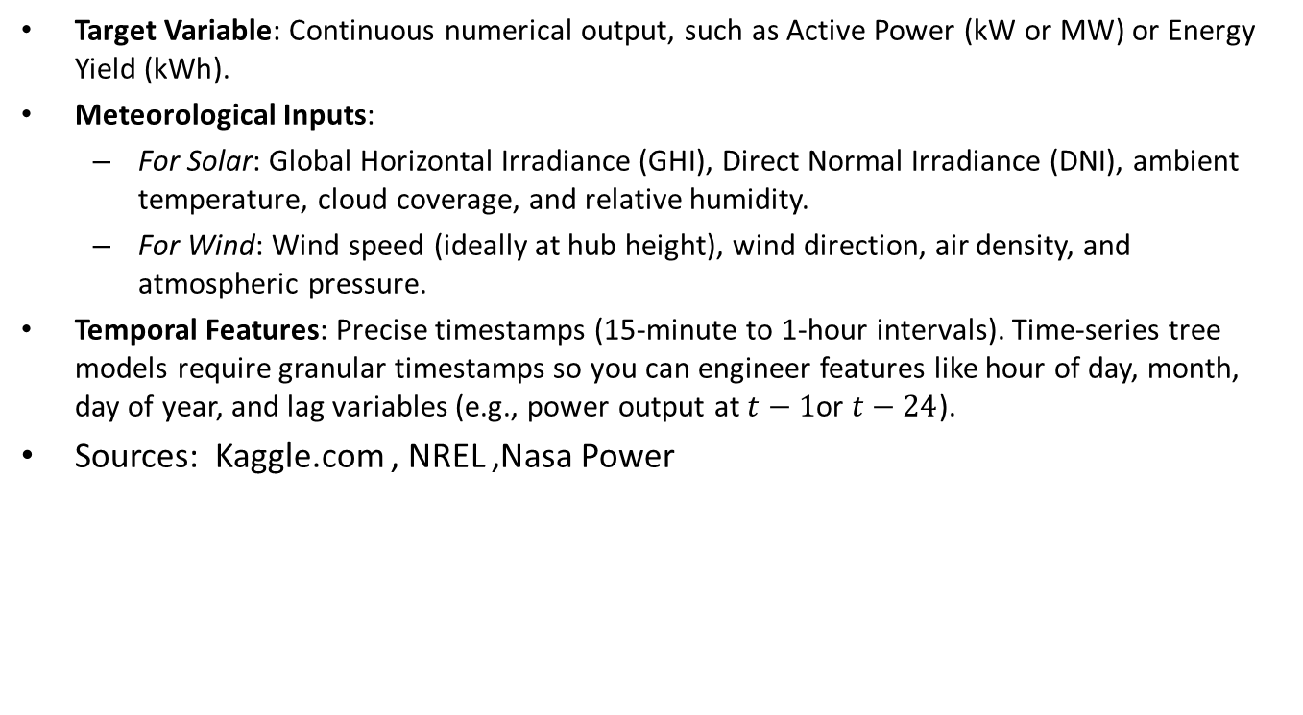
Choosing Dataset
Target Variable: Continuous numerical output, such as Active Power ($\text{kW}$ or $\text{MW}$) or Energy Yield ($\text{kWh}$).
Meteorological Inputs:
  For Solar: Global Horizontal Irradiance (GHI), Direct Normal Irradiance (DNI), ambient temperature, cloud coverage, and relative humidity.
  For Wind: Wind speed (ideally at hub height), wind direction, air density, and atmospheric pressure.
Temporal Features: Precise timestamps (15-minute to 1-hour intervals). Time-series tree models require granular timestamps so you can engineer features like hour of day, month, day of year, and lag variables (e.g., power output at $t−1$or $t−24$).
Sources: Kaggle.com , NREL ,Nasa Power

Slide 7

Dataset Schema & Feature Structure
Feature Category | Specific Variables | Modeling Role
Temporal Drivers | Year, Month, Day, Hour of Day, Day of Year | Captures seasonal trends & diurnal cycles
Meteorological | Wind Speed, Direction, Temperature, Irradiance (GHI/DHI) | Primary physical exogenous inputs
Lagged & Rolling | Power(t-1), Power(t-24), 3h & 24h Rolling Mean/Std | Captures autoregressive time-series memory
Target Variable | Actual Generated Power Output (MW or kW) | Continuous variable for regression output

Slide 8

Dataset Scale & Volume
High-Density Tabular Scale
87.6k
The Dataset contains 17 columns and 1,96,777 rows
The total dataset memory footprint ranges between 50 MB to several GBs, providing optimal scale for gradient boosting without requiring distributed cluster computing.
Hourly Records (10 Years)

